Slide 1
Analyzing air travel in a network through the lens of sociology
Michael Mckenna

Slide 2
Intro
What patterns emerge from simulating air traffic routes as a force-directed graph and how can we interpret the data in terms of geography and culture?
The domestic air transportation network is a culmination of decades of population change and infrastructure advancement. Routes from the six largest airports serve every state and every major metropolitan area. This study embarks on an exploration of the complex interplay between air traffic, geography, and cultural influences by employing a Kamada-Kawai graph and agent-based model.

Slide 3
Literature Review
“The worldwide air transportation network: Anomalous centrality, community structure, and cities' global roles”
This paper identified global air routes as a scale-free small-world network. Their ability to extract information on a city’s global presence according to its air transport connections is a novel method of both data visualization and analyzing political economics.
“Identification of Key Nodes in Aircraft State Network Based on Complex Network Theory”
This paper establishes a method for identifying and assessing conflicts in commercial aviation landing and take off. The terminology and metrics used were very insightful as well as the corresponding visualizations in the study.
“Large-scale agent-based simulation model of pedestrian traffic flows”
The presence of both logical and non-logical behaviors in simulating traffic is important to capturing realism in any model involving human inputs. That, as well as the implicit laws on human behavior used to guide the agent-based model informed my parameters and perspective of my project.

Slide 4
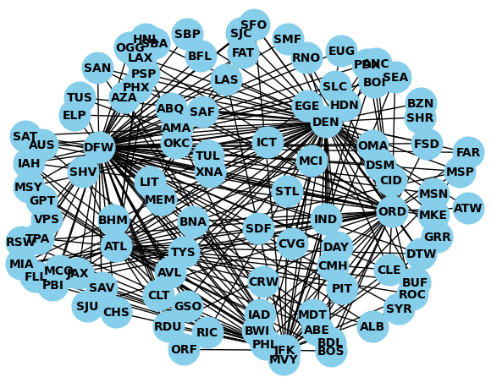
Model Description
A Kamada-Kawai graph of the 6 largest US airports and how they connect to over 100 different airports in all 50 states. The graph accurately portrays relative distance between most cities and provides an insight to population trends and transportation efficiency

Slide 5
Experiment Methodology
Data Analysis:
Using networkx I can analyze various measures of centrality on the vast majority of the US air transportation network.
Using functions for degree, closeness, and betweenness centrality and printing the results to draw conclusions on which airports are strong connecting hubs, located nearest to other airports, and have the most connections
Agent-based Model:
Using the network created for data analysis I can set a stage for an agent-based model using a secondary set of smaller nodes- referred to as agents that move from node to node.
Using a visualization function I can observe the movement of agents around the network and recognize patterns formed by the natural movement of agents in the network
Because the network is an accurate representation of the air transportation network, movement in the model simulates patterns of real flight movement

Slide 6
Results - Data Analysis
It’s understandable that Dallas is home to the most well-connected airport in the US because of its central location, distance from other large cities, and other factors
Cities | Degree | Closeness | Betweenness
New York, NY | 0.42 | 0.6329 | 0.0867
Atlanta, GA | 0.39 | 0.6211 | 0.0812
Chicago, IL | 0.47 | 0.6536 | 0.0722
Dallas, TX | 0.84 | 0.8621 | 0.38
Denver, CO | 0.72 | 0.78125 | 0.2238
Los Angeles, CA | 0.72 | 0.78125 | 0.1901

Slide 7
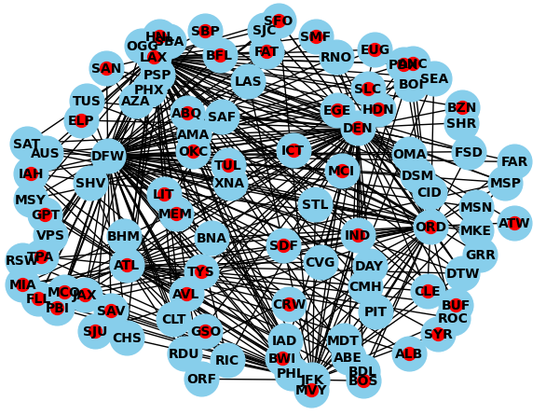
Results - Agent-based Model
Patterns develop in the model where agents travel to certain regions of nodes depending on the hub they travel through. These regions are both cultural and geographical.
Atlanta: Florida + Appalachian/Piedmont
New York: Northeast Corridor + Florida
Denver: Rockies + California
Los Angeles: California + Rockies + Southwest
Texas: Southwest + California + Appalachian/Piedmont

Slide 8
Limitations
Amount of Data
2D Graph
Movement
The capabilities of my model are functionally limited to a subset of pre-existing data because of the practicality of collecting and visualizing data. The model represents a fixed number of hubs and airports which does accurately reflect the vast majority of air travel, however it doesn’t accurately represent all of domestic air travel.
Because of the earth’s spherical shape, no 2-dimensional graph can accurately depict the true distance between two points that accurately preserves both the spatial separation and still provides the shortest path length. There is also the trouble of having outlier nodes that exist outside the continental US like Alaska and Hawaii being fit into the graph.
The agents don’t accurately portray a scaled down movement of actual airplanes because similarly to the distance issue, agents traveling to other nodes as an actual reflection of time and space would require altering the distance data to fit a non-spherical graph and would be very time consuming to iterate every scaled down mile traveled by the agent to its destination

Slide 9

Implications on Efficiency
The current air transportation network has identified the need for alternative modes of travel for distances between 100-500 miles in key population dense corridors like the Northeast, Florida, California, and Piedmont.
There is also an identifiable need for consolidation of airports in cities where airports almost overlap- San Antonio and Austin, Buffalo and Rochester, Miami and Fort Lauderdale
In these areas airports are less than an hour away from each other and compete in both domestic and international travel

Slide 10
Implications on Geography
Areas like the Appalachian/Piedmont region have strong air connections to Atlanta because of culture and geographic separation by the Appalachian mountains
Similarly in the Rockies, Denver connects various cities in very close proximity because of their geographic separation and the relatively weak ground infrastructure between them. These services are often subsidized by the federal government as essential to the needs of remote and rural communities

Slide 11
Implications on Culture
Los Angeles being the dominant hub among California airports and the Southwest is due to its unique cultural identity. With a very high hispanic population, L.A is demographically very similar to other southwestern cities. Historically being the frontier of both the Spanish and Mexican empires, this unites the region.
The role L.A plays in the state of California is being a focal point for commerce and international access. With large inland cities and political power located in central California like Fresno and Sacramento, their ties to L.A and its economic power are vital to the unity of the state.

